Slide 1
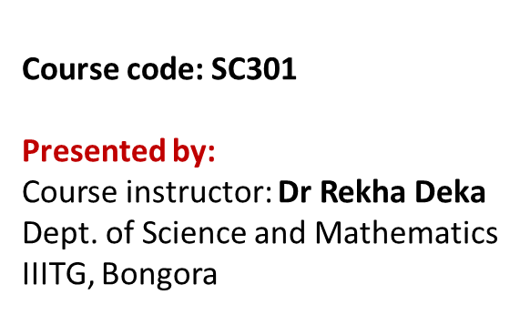

Unit IV- Human physiology Circulatory system/ Cardiovascular System
Contents | Slide No.
Blood composition | 2
2. Anatomy of Heart | 5-12
3. Double circulation-pulmonary and systemic | 17-18
4. Three subdivisions of systemic circulation | 19-20
5. Blood vessels involved in pulmonary and systemic circulation | 21-22
6. Conduction system of heart | 23-29
7. Sinoatrial node is the pacemaker of heart | 30
8. Cardiac cycle | 31-32
9. Electrocardiogram and its graphics | 33-36
10. Cardiac output | 37
11.Heart sound, Heart beat and Pulse and Blood pressure | 38
12. Nervous and Chemical control of heart rate | 39

Slide 2
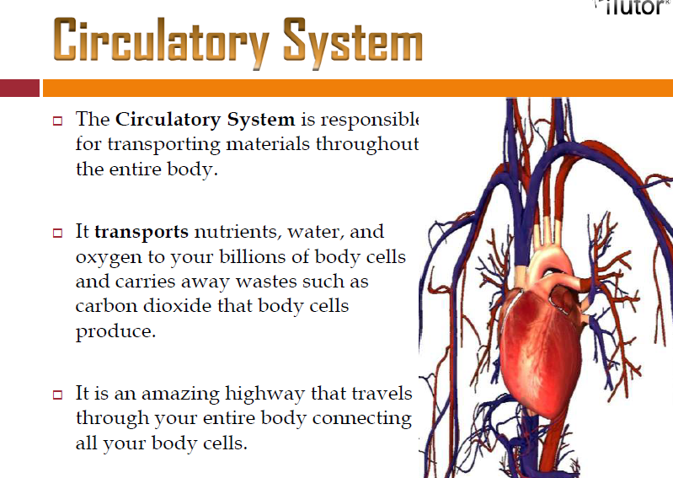
e

Slide 3
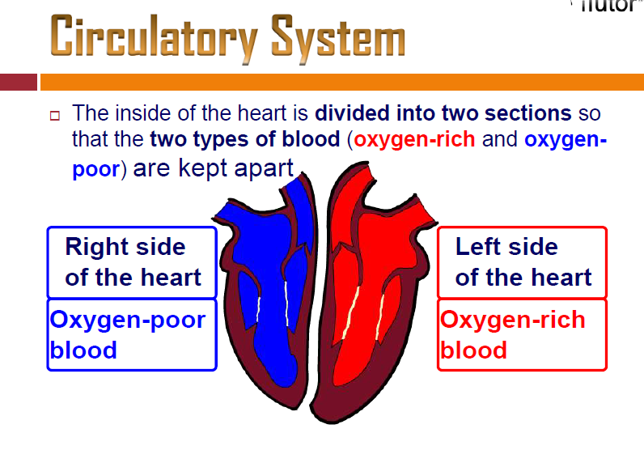

Slide 4
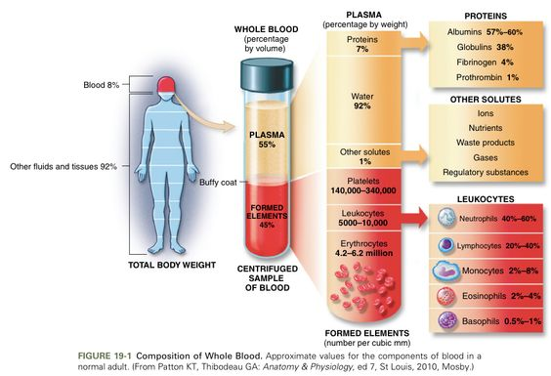
Blood composition
Blood is the fluid medium in which materials are transported around the body via blood vessels
An average adult human contains roughly 5 – 6 litres of blood (approximately 77 mls per kilogram)
When blood is fractionated by centrifugation, three key elements become apparent
Fractionated blood contains roughly 55% plasma, 45% red blood cells and less than 1% forms a buffy coat
Granulocytes:
Neutrophils (60-70% )
Eosinophils (2-4%)
Basophils (0.5-1%)
Agranulocytes:
Lymphocytes (B-cells and T-cells) (20-25%)
Monocytes (3-8%)

Slide 5
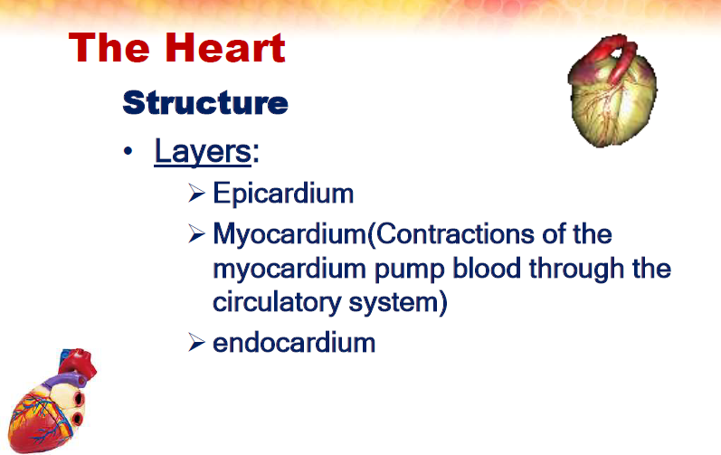
(Pericardium)

Slide 6
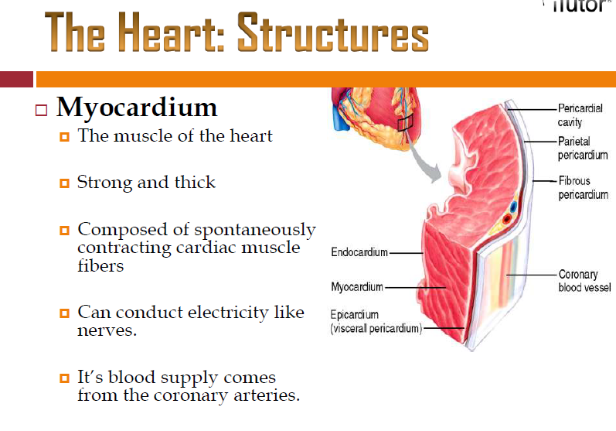

Slide 7
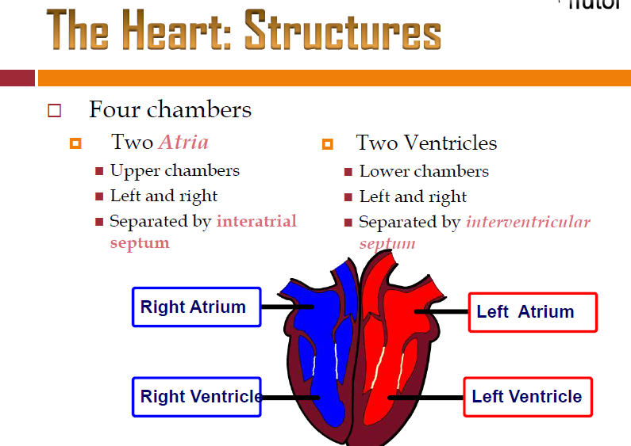
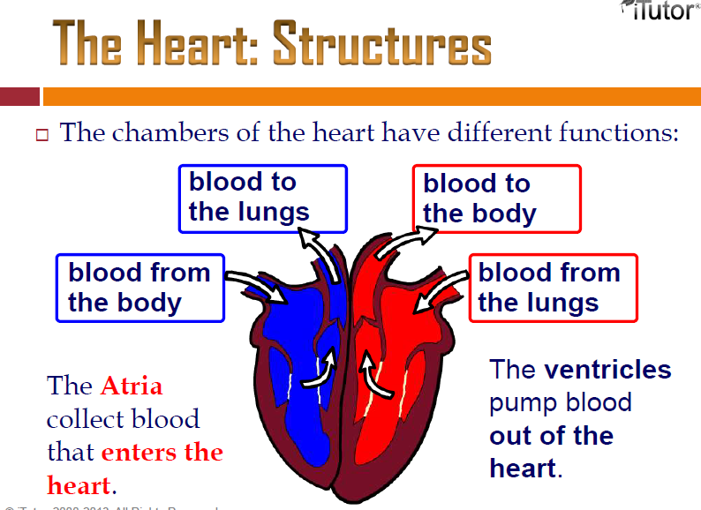

Slide 8
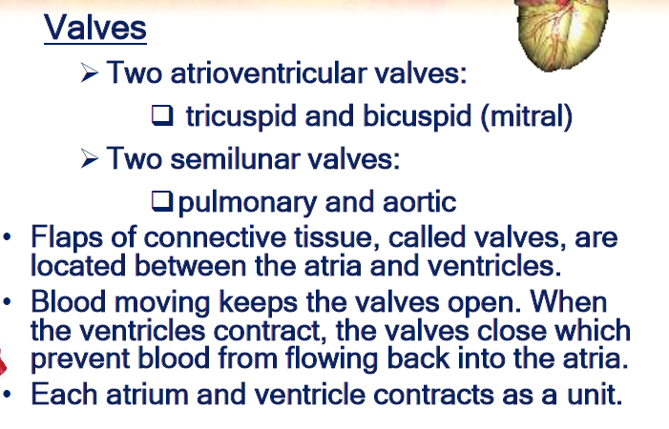

Slide 9
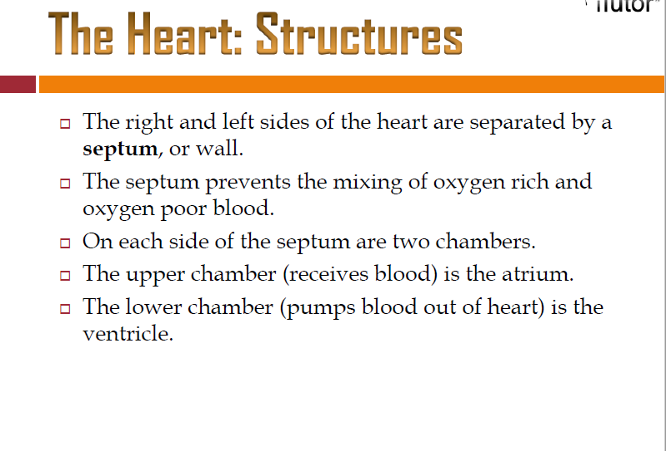
Septum- separation by walls between chambers
Interatrial septum : Walls between two atrium, left and right
Intraventricular septum : Walls between two ventricles, left and right
Atrio-ventricular septum : walls between atrium and ventricles.

Slide 10
Blood vessels of the heart for pulmonary circulation
Pulmonary artery- Deoxygenated blood travels to the lungs (left as well as right). It is the only artery that carries deoxygenated blood for purification in the lungs.
Pulmonary veins-
Oxygenated blood returns to the heart (left side from the lungs). The pulmonary veins are the only veins that carry oxygenated blood.
Aorta: large artery that carries oxygenated blood to small arteries and distribute them to different parts of body.
Superior Vena Cava- large veins that returns deoxygenated blood from head and arms to the heart.
Inferior Vena cava-large veins that returns deoxygenated blood from abdominal organs and legs to the heart. Blood vessels from abdominal organs such as gastrointestinal tract first enters the hepatic portal circulation and then joins the inferior vena cava.

Slide 11
Blood vessels involved in systemic circulation
Arteries:
Carries oxygenated blood away from the heart to different body parts.
Arteries are large, elastic, thick-walled and muscular. They expand to fill with blood and then propel it forward as they return to their normal diameter.
Blood is carried under high pressure.
Arteries ends up in arterioles in tissues.
2. Veins
Carries deoxygenated blood or impure blood from different body parts towards the heart.
Veins are less muscular.
Valve is present which is called vein valve. The presence of valve prevent blood flowing backwards under the force of gravity.
Venules smaller channel take blood to the veins.
3. Capillaries
Smallest vessels, microscopic, nutrients and gases diffuse here.

Slide 12
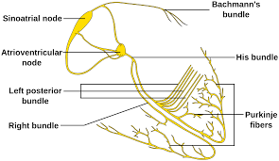
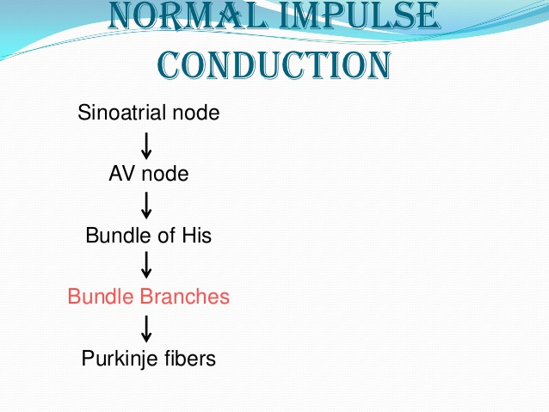
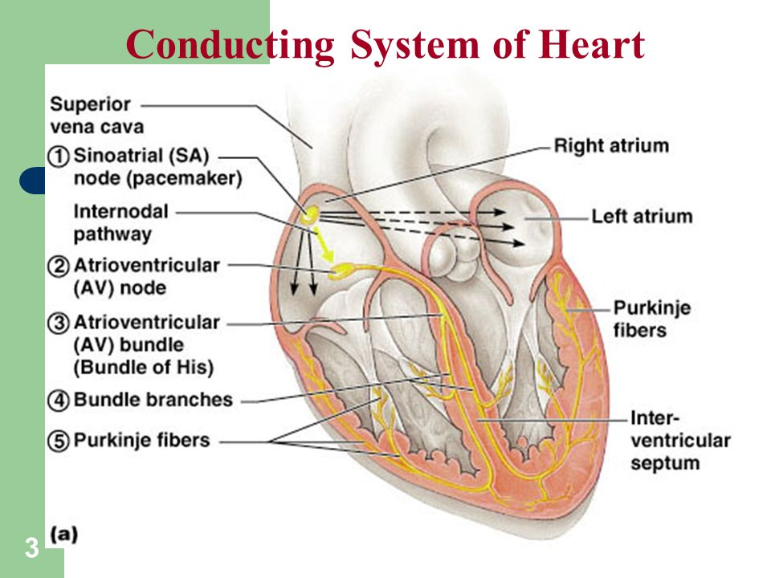
Cardiac muscles of the heart
- Conduction system of the Heart

Slide 13
Sinoatrial node (SA node): located in the right atrial wall just inferior to the opening of the superior vena cava. Cardiac excitation begins in the SA node. An action potential spontaneously arises in the SA node and then conducts throughout both atria via gap junctions in the intercalated discs of atrial fibres. Following, the action potential, the two atria finish contracting at the same time.
Atrioventricular node (AV node): AV node is located in the interatrial septum, just anterior to the opening of the coronary sinus. The action potential reaches the AV node, where the action potential slows considerably, providing time for the atria to empty their blood into the ventricles.
Atrioventricular bundle (Bundle of His): The action potential from the AV node, enters the Bundle of His. The AV bundle is the only site where action potentials can conduct from the atria to ventricles.
Right and left bundle branches : After conducting along the AV bundle, the action potential then enters both the right and left bundle branches that course through the interventricular septum toward the apex of the heart.
Purkinje fibres: These fibres rapidly conduct the action potential, first to the apex of the ventricles and then upward to the remainder of the ventricular myocardium. Then, a fraction of a second after the atria contract, the ventricles contract.

Slide 14
Human circulatory system is closed type
Closed type- Blood flows around the body through the specific blood vessels. Aorta, arteries, arterioles, venules, veins, and vena cava are specific blood vessel found in human circulatory system. The path of flow of blood in a closed system is given below:
Blood from the heart (oxygenated and pure)→ aorta→ arteries → arterioles→ tissues → venules → veins → vena cava → back to heart (deoxygenated and impure).

Slide 15
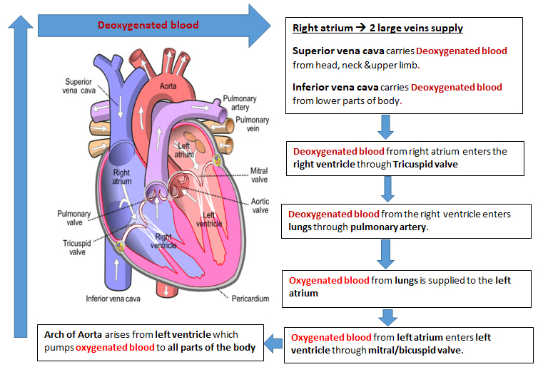
Path of blood flow

Slide 16
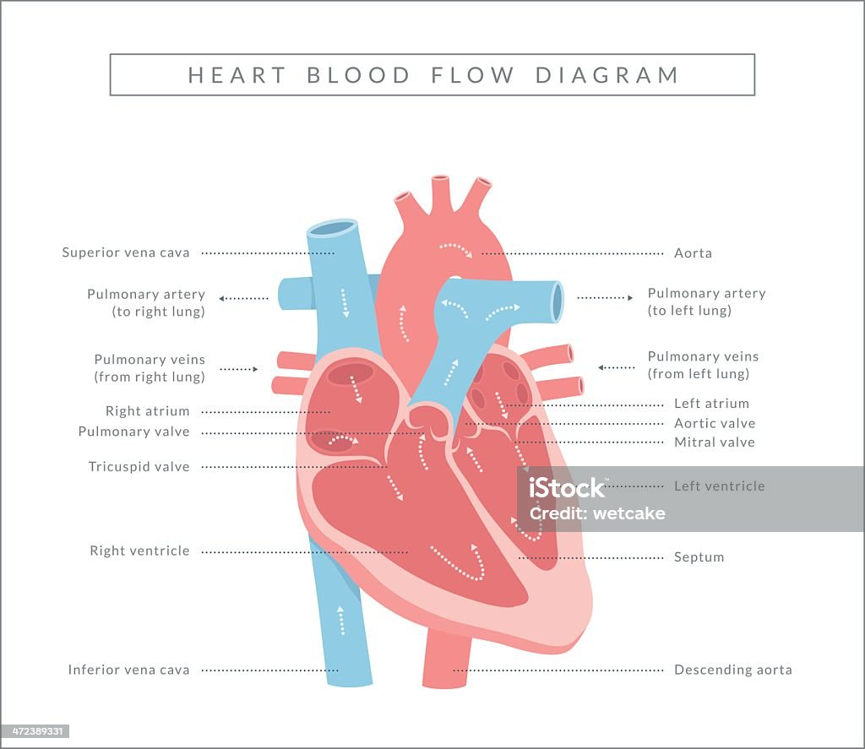

Slide 17
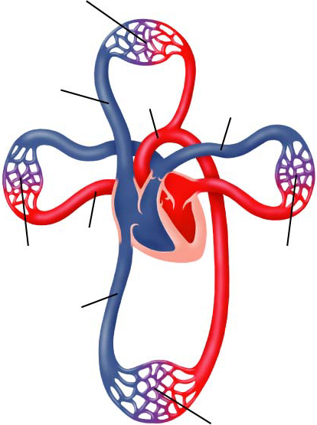
Double circulation: Pulmonary and Systemic
Capillaries of head and arms
Superior vena cava
Pulmonary artery
Aorta
Pulmonary vein
Capillaries of right lung
Capillaries of left lung
Inferior vena cava
Capillaries of abdominal organs and legs

Slide 18
What is Double circulation?
1. Pulmonary (lungs) Circulation
Deoxygenated blood or impure blood from right ventricle of the heart carried to lungs and oxygenated blood back to the left ventricle of the heart (heart & lungs)
2. Systemic (body) Circulation
Includes all arteries and arterioles that carry Oxygenated blood from the left ventricle to systemic capillaries, plus the veins and venules that carry deoxygenated blood returning to the right atrium after flowing through body organs. It has three subdivisions: Coronary circulation, cerebral circulation and hepatic portal circulation.

Slide 19
Three subdivisions of systemic circulation
1) Coronary circulation: includes coronary arteries that supplies blood to all the layers of cells that make up the heart wall (myocardium). It delivers oxygen and nutrients to the heart muscle and collects carbon dioxide and waste, and then moves into coronary veins.
2) Cerebral circulation: blood supplied to brain.
3) Hepatic portal circulation: The portal venous system is responsible for directing blood from parts of the gastrointestinal tract (GI tract) to the liver. Substances absorbed in the small intestine travel first to the liver for processing before continuing to the heart. Blood flow to the liver is unique in that it receives both oxygenated and (partially) deoxygenated blood. Many drugs that are absorbed through the GI tract are substantially metabolized by the liver before reaching general circulation.

Slide 20
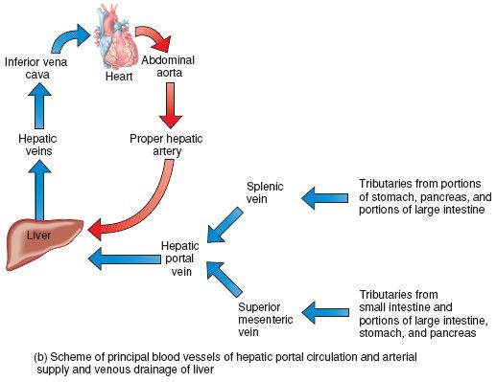
Hepatic portal circulation

Slide 21
Blood vessels of the heart for pulmonary circulation
Pulmonary artery- Deoxygenated blood travels to the lungs (left as well as right). It is the only artery that carries deoxygenated blood for purification in the lungs.
Pulmonary veins-
Oxygenated blood returns to the heart (left side from the lungs). The pulmonary veins are the only veins that carry oxygenated blood.
Aorta: large artery that carries oxygenated blood to small arteries and distribute them to different parts of body.
Superior Vena Cava- large veins that returns deoxygenated blood from head and arms to the heart.
Inferior Vena cava-large veins that returns deoxygenated blood from abdominal organs and legs to the heart. Blood vessels from abdominal organs such as gastrointestinal tract first enters the hepatic portal circulation and then joins the inferior vena cava.

Slide 22
Blood vessels involved in systemic circulation
Arteries:
Carries oxygenated blood away from the heart to different body parts.
Arteries are large, elastic, thick-walled and muscular. They expand to fill with blood and then propel it forward as they return to their normal diameter.
Blood is carried under high pressure.
Arteries ends up in arterioles in tissues.
2. Veins
Carries deoxygenated blood or impure blood from different body parts towards the heart.
Veins are less muscular.
Valve is present which is called vein valve. The presence of valve prevent blood flowing backwards under the force of gravity.
Venules smaller channel take blood to the veins.
3. Capillaries
Smallest vessels, microscopic, nutrients and gases diffuse here.

Slide 23
Conduction system of the Heart
cardiac muscles of the heart

Slide 24
Conduction system of the Heart
1) The conduction system of heart comprises of cardiac muscles.
About 1 percent of the cardiac muscle fibres are different from all others because they can generate action potentials over and over and do so in a rhythmical pattern. They continue to stimulate a heart to beat even after it is removed from the body-for example, to be transplanted into another person—and all of its nerves have been cut. The nerves regulate the heart rate but do not determine it.
2. The cells of cardiac muscle fibres have two important functions:
they act as pacemaker, setting the rhythm for the entire heart, and
they form the conduction system, the route for action potentials throughout the heart muscle.
2). The conduction system ensures that cardiac chambers are stimulated to contract in a coordinated manner, which makes the heart an effective pump; Cardiac action potentials pass through the following components of the conduction system:

Slide 25
Sinoatrial node (SA node): located in the right atrial wall just inferior to the opening of the superior vena cava. Cardiac excitation begins in the SA node. An action potential spontaneously arises in the SA node and then conducts throughout both atria via gap junctions in the intercalated discs of atrial fibres. Following, the action potential, the two atria finish contracting at the same time.
Atrioventricular node (AV node): AV node is located in the interatrial septum, just anterior to the opening of the coronary sinus. The action potential reaches the AV node, where the action potential slows considerably, providing time for the atria to empty their blood into the ventricles.
Atrioventricular bundle (Bundle of His): The action potential from the AV node, enters the Bundle of His. The AV bundle is the only site where action potentials can conduct from the atria to ventricles.
Right and left bundle branches : After conducting along the AV bundle, the action potential then enters both the right and left bundle branches that course through the interventricular septum toward the apex of the heart.
Purkinje fibres: These fibres rapidly conduct the action potential, first to the apex of the ventricles and then upward to the remainder of the ventricular myocardium. Then, a fraction of a second after the atria contract, the ventricles contract.

Slide 26
Arrangement of cardiac muscles of the heart

Slide 27
Arrangement of cardiac muscles of the heart

Slide 28
Sinoatrial node is the pacemaker of heart
The SA node sets the rhythm for contraction of the heart. It initiates action potentials about 100 times per minute faster than any region of the conducting system.
Various hormones and neurotransmitters can speed or slow pacing of the heart by SA node fibres. In a person at rest, for example, acetylcholine released by the parasympathetic division of the autonomic nervous system (typically slows SA node pacing to about 75 action potentials per minute, causing 75 heart beats per minute.
If the SA node becomes diseased or damaged, the slower AV node fibres can become pacemaker. With pacing by the AV node, however heart rate is slower, only 40 to 60 beats per minute. If the activity of both nodes is suppressed, the heart beat may still be maintained by the AV bundle, a bundle branch or Purkinje fibres. These fibres generate action potentials very slowly, about 20-35 times per minute. At such a low heart rate, blood flow to the brain is inadequate.

Slide 29
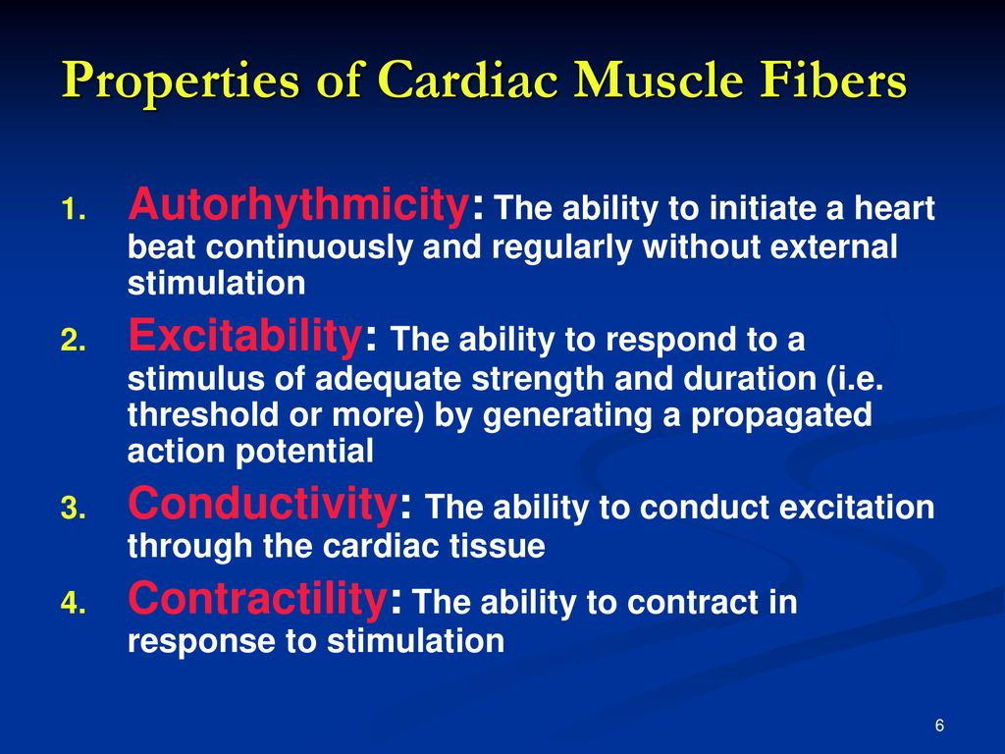

Slide 30
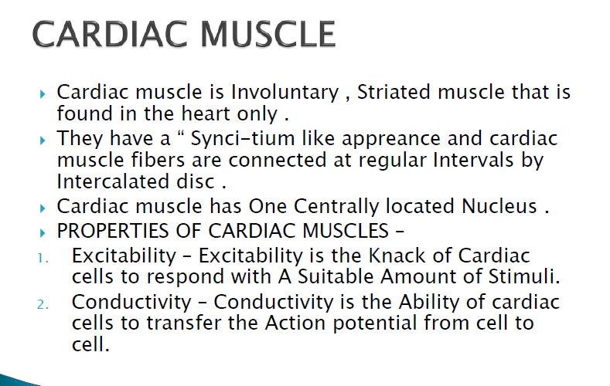
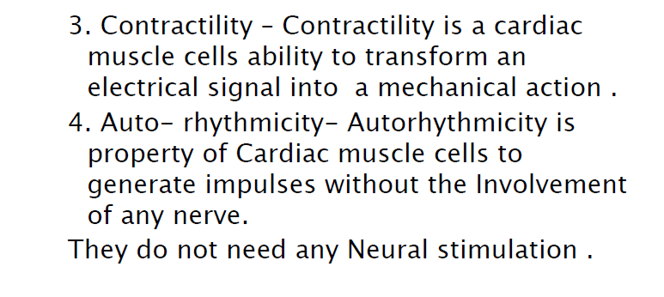

Slide 31
Cardiac cycle
The sequence of event which occur from the beginning of one heart beat to the beginning of the next heart beat is called cardiac cycle.
The four events that occur in cardiac cycle are as follows :
Atrial systole: An action potential from the SA node causes atrial depolarization. Under normal conditions blood continuously enters into right atrium through superior vena cava and inferior vena cava. The pulmonary vein bring blood to left atrium from lungs. 70% of blood passively flows into the ventricles through the opened AV valves and rest 25% is pumped into the ventricles by contraction of atria.
Ventricular filling: AV valve still opens, and nearly 1/3rd of the ventricle is filled with blood at the end of atrial systole. Each ventricle contains about 130 ml of blood at the end of atrial systole.
Ventricular systole/ Ventricular depolarization. When atrial systole comes to an end, the action potential from SA node passes to AV node as well as to the walls of ventricles. Consequently, ventricles contract which results in the rise of ventricular pressure and both the AV valves closes to prevent the back flow of blood. The contraction of ventricle is so strong that semilunar valves open. The blood is pumped into pulmonary artery and aorta from right and left ventricles, respectively. Ejection continues until the ventricles start to relax. At rest, the volume of blood ejected from each ventricle during ventricular systole is about 70 ml.
d) Ventricular diastole:
Ventricular systole is followed by ventricular diastole during which there is fall in ventricular pressure. The semilunar valve closes. At the same time AV valve opens to allow the flow of blood from both the atria to respective ventricles. The relaxation period begins at end of a cardiac cycle when the ventricles start to relax and all the four chambers are in diastole.

Slide 32
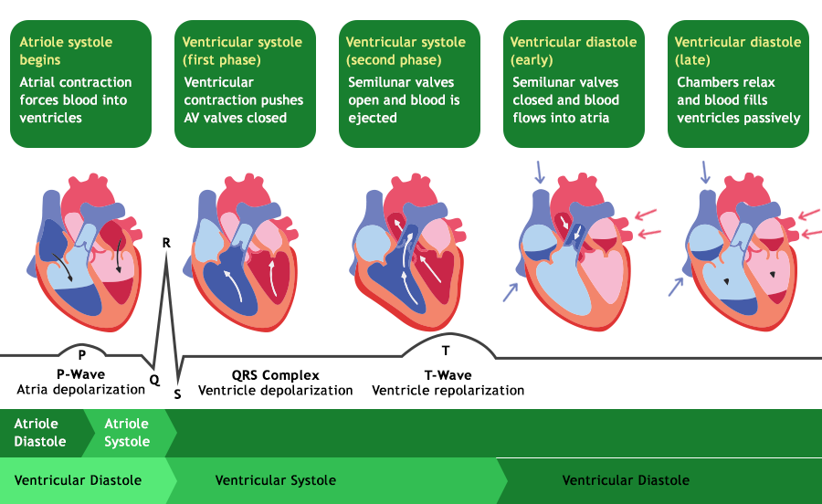
Cardiac cycle

Slide 33
Electrocardiogram (ECG)
Conduction of action potentials through the heart generates electrical currents that can be picked up by the electrodes placed on the skin. A recording of the electrical changes that accompany the heart beat is called an electrocardiogram.
Electrocardiogram is a graphical recording of electrical conduction in the heart over a period of time using electrodes placed over a skin.

Slide 34
Graphics of normal ECG
Understanding the Graphics of normal Electrocardiogram (ECG)
Normal ECG records is composed of following wave pattern which is shown in tabular form.
ECG waveform | What does it indicate? | Amplitude (mV) | Duration (secs)
P wave | which is a small upward wave that indicates the depolarization of atria, or spread of impulse from SA node throughout the atria. | 0.25 | 0.12-0.22
QRS complex | this wave begins as a downward deflection (Q wave), large upright and triangular wave (R wave), and ending as downward wave (S wave). QRS complex is the indication of repolarization of atria and depolarization of the ventricles | 1.6 | 0.07-0.1
S-T interval | ventricular contraction
T wave | it indicates ventricular repolarization | 0.1-0.5 | 0.05-0.15
U wave | Slow repolarization of intraventricular septum (relaxation of purkinje fibres) | <0.1 | 0.2

Slide 35
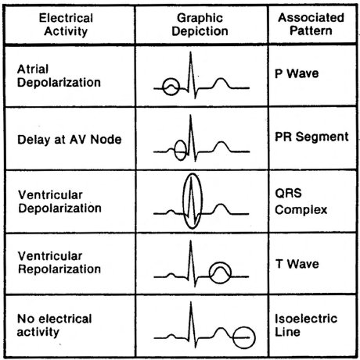
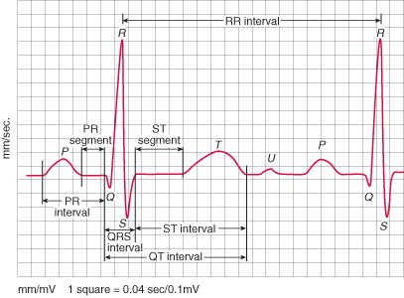
Graphics of normal ECG

Slide 36
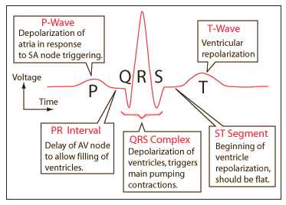
Graphics of normal ECG

Slide 37
Cardiac output
Cardiac output: It is the volume of blood ejected per minute from the left ventricle into the aorta is called cardiac output (CO).
Cardiac output is determined by:
Stroke volume (SV), the amount of blood ejected by the left ventricle during each beat (contraction) and;
Heart rate (HR), the number of heart beats per minute.
In a resting adult, stroke volume averages 70 ml, and heart rate is about 75 beats per minute. Thus, the average cardiac output in a resting adult is
Cardiac output= stroke volume x heart rate
= 70 ml/beat x 75 beats /min
= 5250 ml/min or 5.25 litres /min
3) Factors that increase stroke volume or heart rate, such as exercise, increase cardiac output

Slide 38
What is Heart Sound?
The rhythmic closure and opening of the valves cause the sound of heart beat.
Closing of AV valve causes “lubb sound”.
Closing of semilunar valve at the end of ventricular systole causes “dubb sound”.
What is Heart beat and pulse?
The human heart beats at the rate of about 72-80 per minute in resting condition.
Arterial pulse: It is a wave of distension that passes along the arteries immediately after a ventricular systole. The pulse rate increases during exercise, fever, and emotional and psychological excitements.
What is a Blood pressure?
Blood pressure is a measure of the force exerted by the blood on the wall of the arteries.
An example is 120/80 (systolic pressure/diastolic pressure).
Systolic pressure is the result of the contraction of the ventricles (normal 110-140) Diastolic pressure is during the ventricle relaxation (normal 70-90)

Slide 39
Nervous control of heart rate:
Nervous control of cardiovascular system originates in the cardiovascular centre (CV) in the medulla oblongata.
Sympathetic nerves and norepinephrine released from it increases the heart rate.
Parasympathetic nerve or vagus nerve arise from cardiovascular centre (CV) reach the heart releases acetylcholine that decreases the heart rate by slowing the pacemaking activity of SA node.
Chemical regulation of heart rate:
Hormones: epinephrine and norepinephrine enhance heart’s pumping effectiveness by increasing both heart rate and contraction force. Exercise, stress, and excitement cause adrenal medulla to release more hormones.
Ions: Elevated level of K⁺ and Na⁺ decrease heart rate and contraction force. A moderate increase Ca²⁺ level increases heart rate and contraction force.

